Slide 1
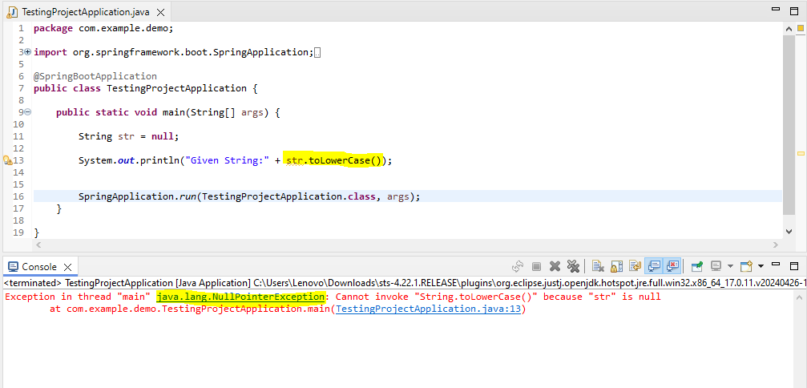

Slide 2
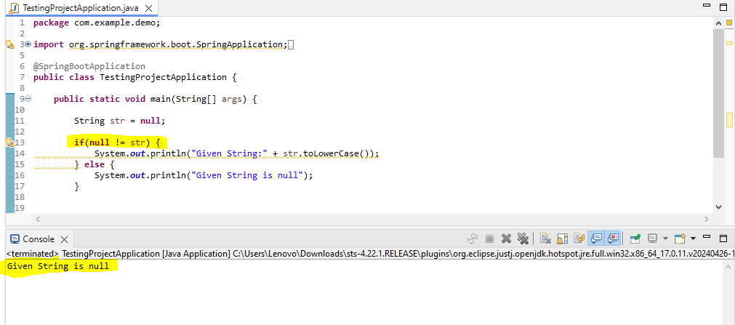

Slide 3
OPTIONAL METHODS
Optional.empty()
Optional.of()
Optional.ofNullable()

Slide 4
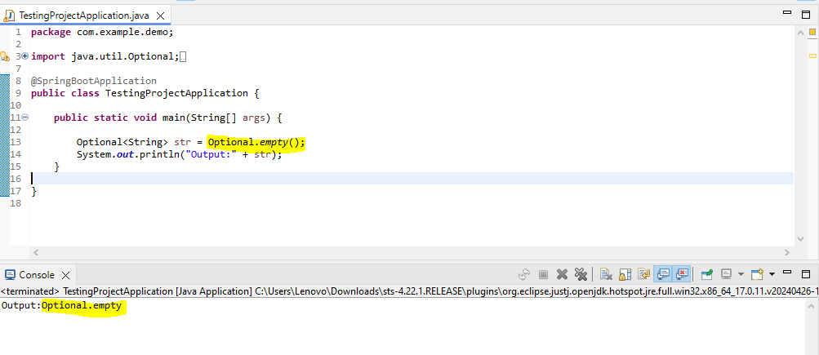
Optional.empty() – Explicitly returning an empty container

Slide 5
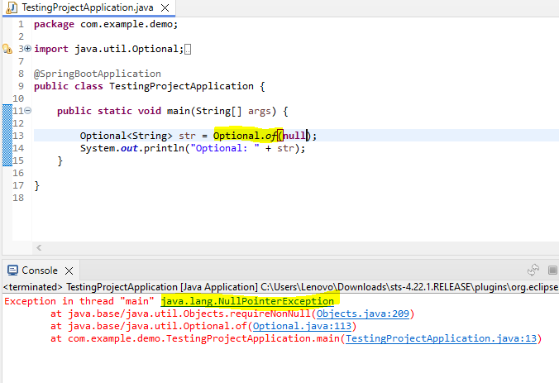
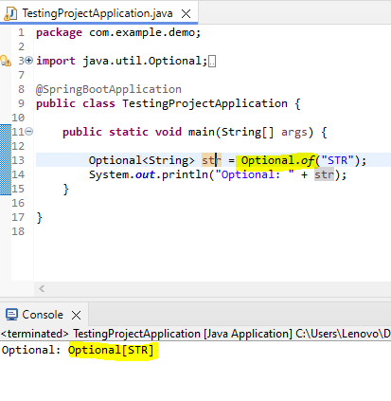
Optional.of() – when container will always return a value

Slide 6
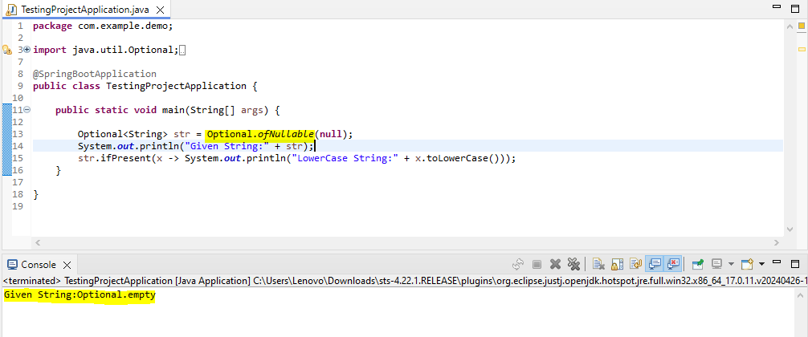
Optional.ofNullable() – when container return value is null or non-null

Slide 7
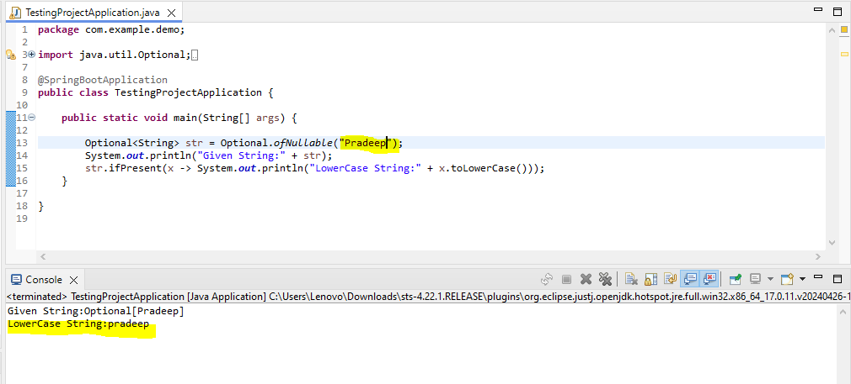

Slide 8
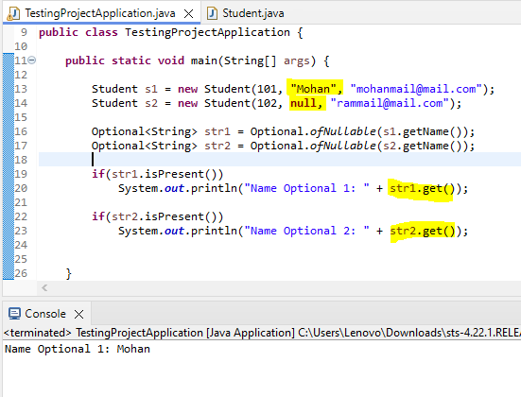
isPresent() & get()

Slide 9
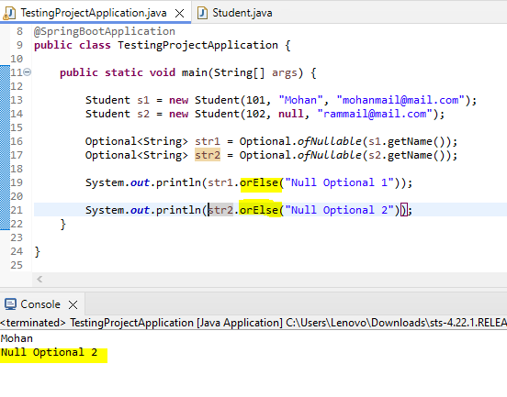
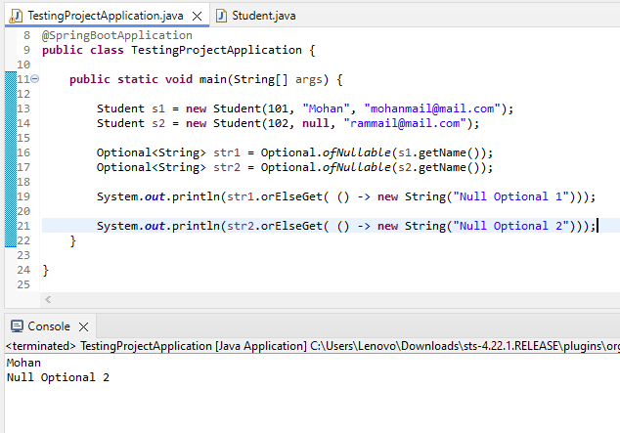
orElse() orElseGet()

Slide 10
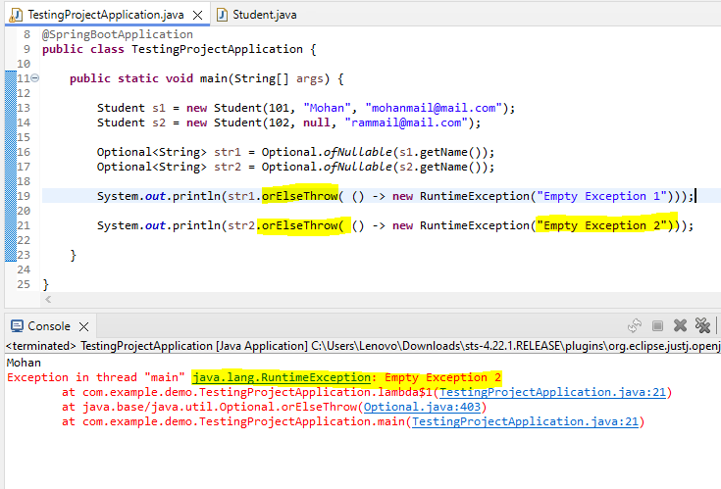
orElseThrow()

Slide 11
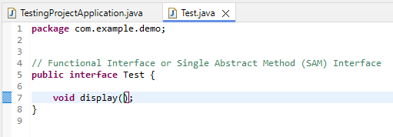
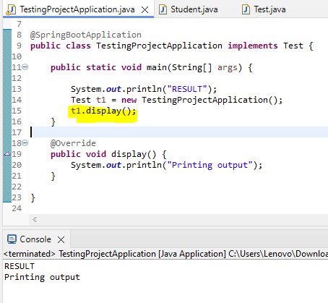
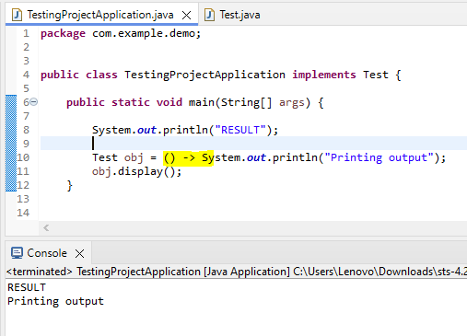
Lambda Expression
Existing flow < Java 8
Current flow on Java 8

Slide 12
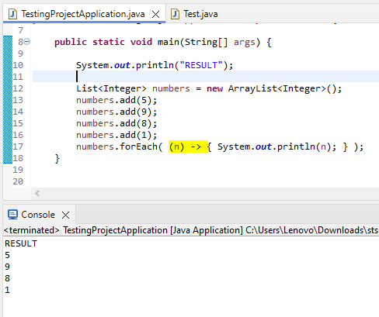

Slide 13
METHOD REFERENCE
Lambda Expression → When Implementation needs to be defined
Method Reference → When Implementation is already there
TYPES:
Static Method
Instance Method or Non-Static Method
Constructor

Slide 14
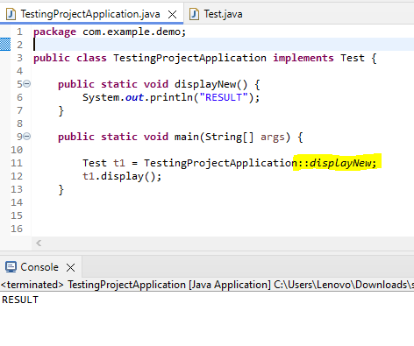
Reference to Static Method

Slide 15
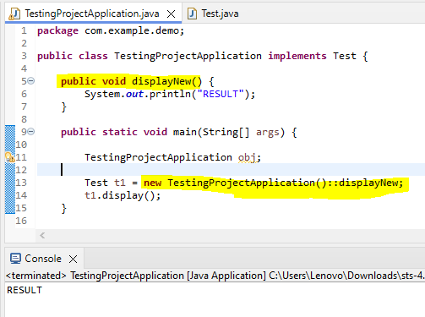
Reference to Instance Method

Slide 16
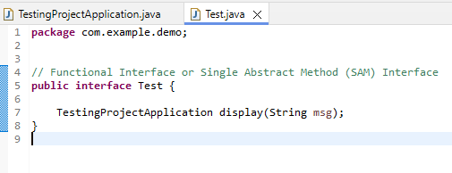
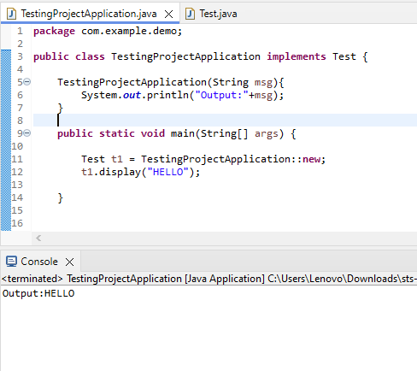
Reference to a Constructor

Slide 17
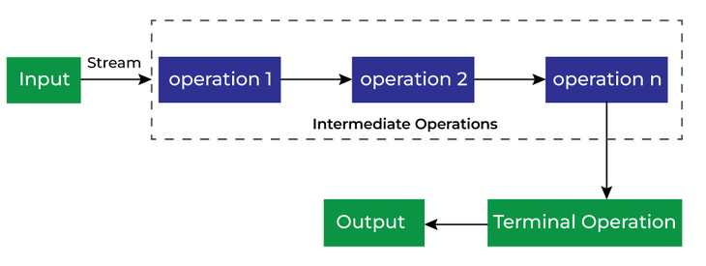
STREAMS
Data Processing like filtering, mapping, reducing and sorting
Doesn’t store elements
A stream is not a data structure (don’t change the original data structure)

Slide 18
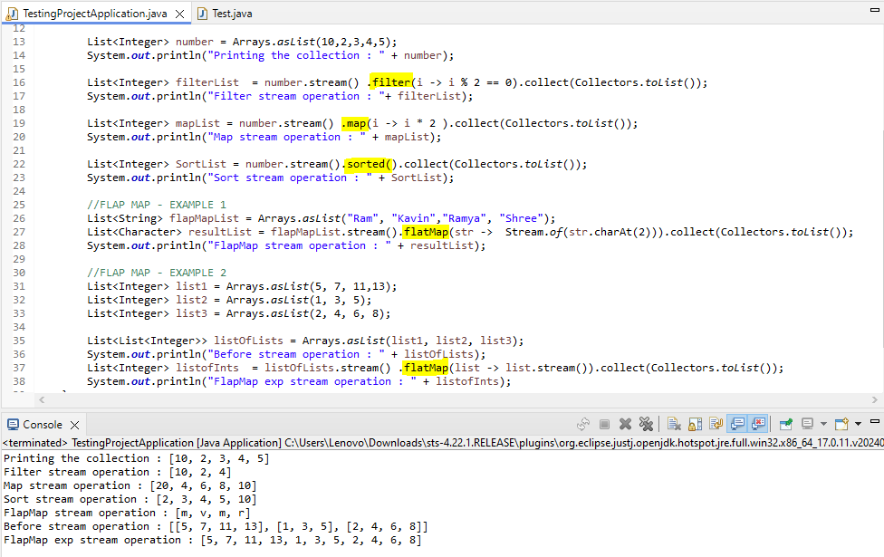
Intermediate operations – Filter, Map, Sorted, FlapMap

Slide 19
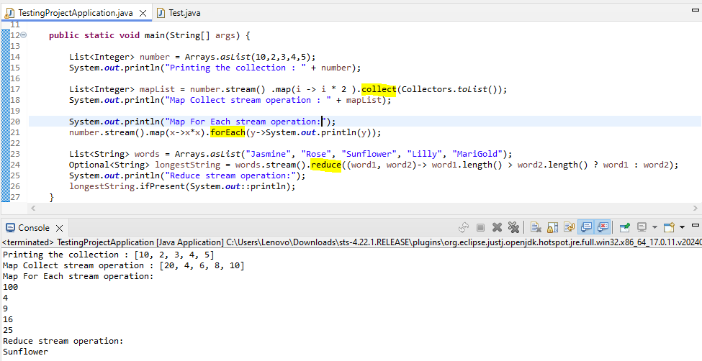
Terminal operations – Collect, ForEach, Reduce

Slide 20
